Slide 1
IRRATIONAL GRAVITY SQUAL
Crazy eight ball alternative reminiscing

Slide 2
Magic 8 ball
Start with a team name:
Irrational Gravity Squall
Keira, Kevin, Aaron and Askar
Make it Light! Fun! Engaging!!!!
Games! Everyone loves games
Team Norms: Idea’s are always good ideas, be respectful of others, no question is a dumb question, have fun
Challenge yourself! Work on a weakness and make it a strength!

Slide 3
Irrational gravity squall
Technologies used:
Firebase Database
HTML5/CSS
Materialize
Javascript
JQuery

Slide 4
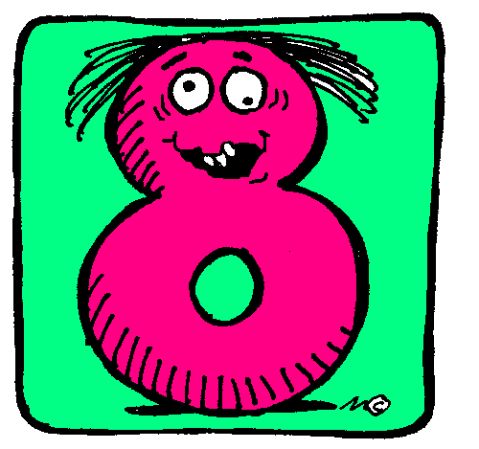
Magic 8 ball concepts
Enter your name and month and day of birth
The application will return not your typical 8 ball answer, but search api’s (random) to return information about you!! (well, about something that happened on your birthday)

Slide 5
Magic 8 ball alternative reminscing
New York Times
Returns random articles between a set of random years that were released on your birthday!
OMDB
Returns random movie relased between a set of random years that were released around your birthday
KITTENS!!!!!

Slide 6
Irrational gravity sqall
Future enhancements
Originally meant to return funny horoscopes based on your sun sign (hard to find acceptable and secure horoscope api)
Originally thought we could use NOAA, however the data structure is very complex
Will work on building out functionality to return more than one result, and have Materialize rotate through results in a carousel
Will work to use data stored to return another result!!!!

